Slide 1
End of Internship Presentation Alex Lin
Boston Fusion Corp.
70 Westview Street, Suite 100
Lexington, MA 02421
www.bostonfusion.com
14 August 2023
Notes:
Overall talk about what was interesting to me

Slide 2
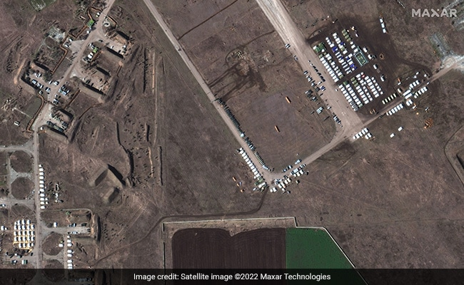
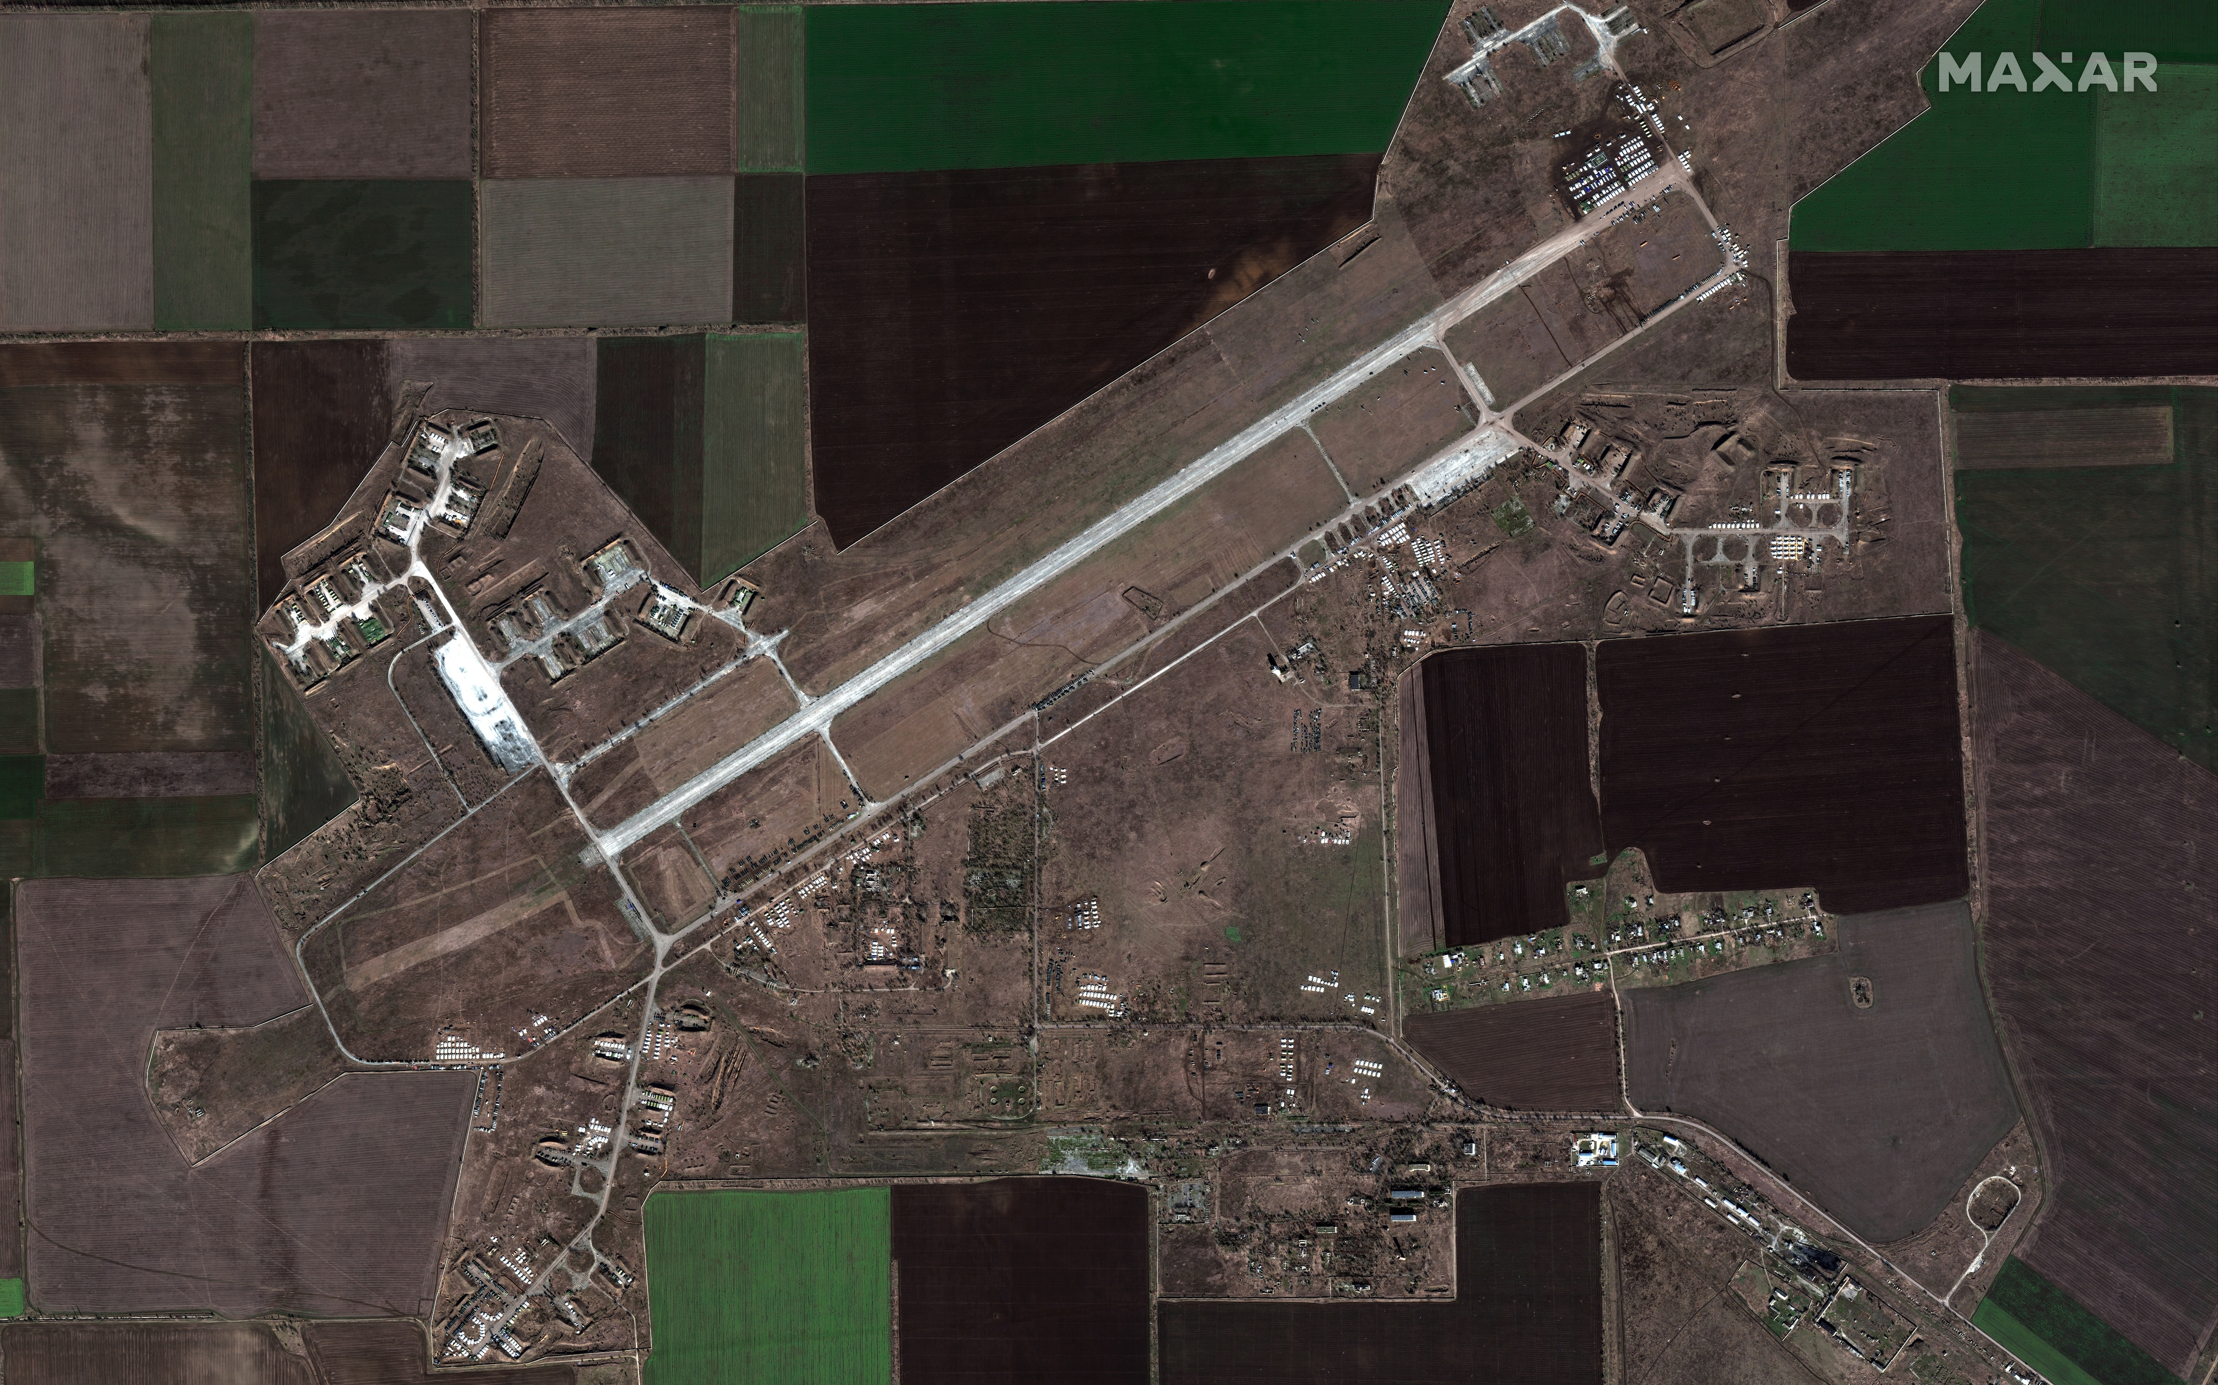
Project Overview: ARCLIGHT: Automated Clustering and Curriculum Learning Guided by Human Training
Operational Need
Analyst toolset to identify and prioritize information within massive data streams in critical, time-sensitive scenarios with evolving conditions to inform decision makers
Primary Objectives
Create/maintain knowledge graph
Automatically acquire concepts from multimedia data
Solicit input from human analysts to refine, correct, and update knowledge
Expected Outcomes
ARCLIGHT accelerates the discovery of adversarial entities, capabilities, and activities in a dynamic environment while minimizing the burden on human teammates
Maxar Technologies
This base was abandoned, but there appear to be increasing numbers of tents and armored personnel carriers.
Due to presence of airfield, this may be a new staging area.
hashtags: curriculum learning, continuous learning, neuro-symbolic, semantic technologies, knowledge acquisition
Maxar Technologies

Slide 3
Baseline
*CVAT: Computer Vision Annotation Tool
Object Detection
Faster R-CNN
mAP
Data
Top1 Acc.
Task
Activity Classification
VideoMAE
Mux
Analytic Error
Multi-Modal Class.
Multi-Modal Classifier
Top1 Acc.
Baseline
Collection of Expert Systems
My Role
Build minimum viable baseline
Motivation
Interest in object detection, application of ML
Tools
Triton Inference Server, ONNX, Docker, Pytorch, Fiftyone, CVAT, YOLO, mask-rcnn
Notes:
What motivated me to the role:
Setting up problem for the summer
Focus of talk will be on the minimum viable baseline architecture

Slide 4
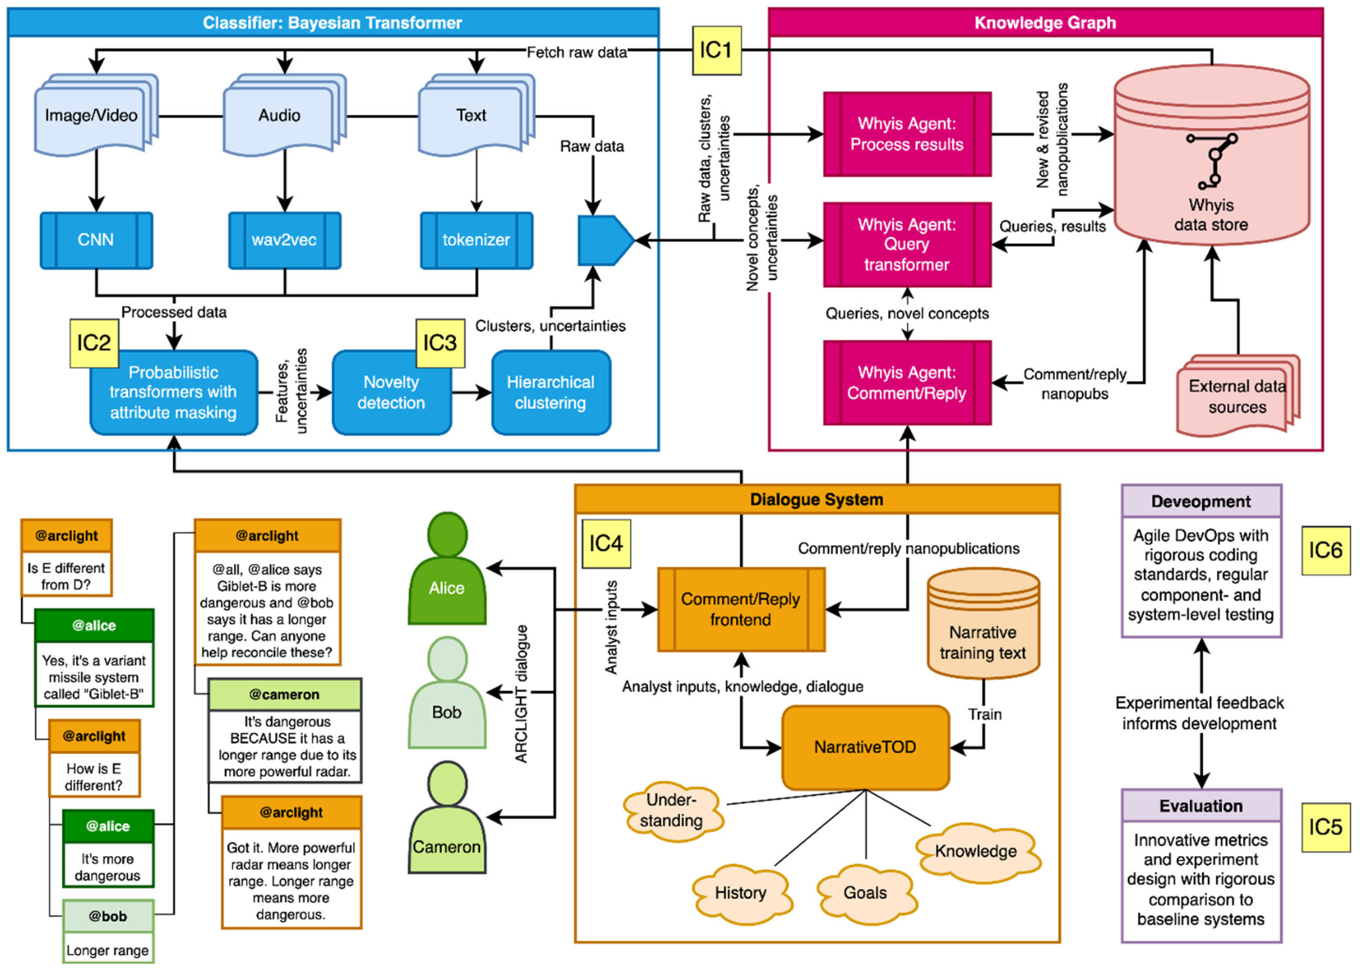
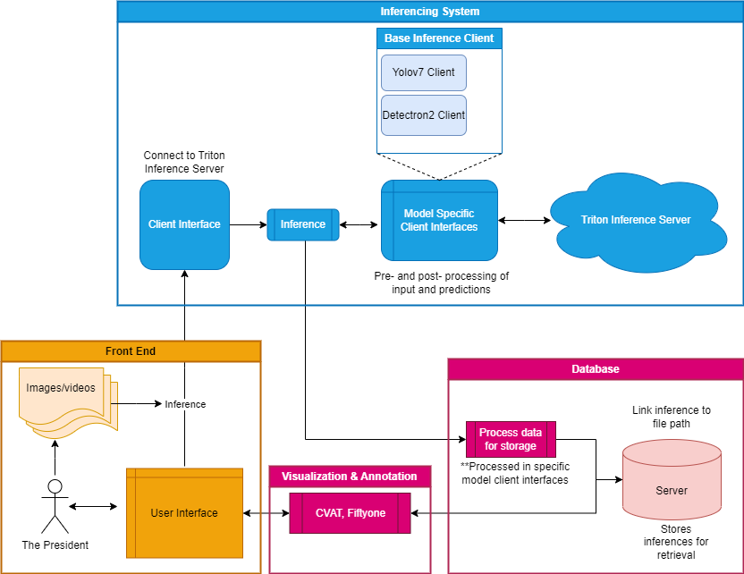
Baseline Framework
Proposed ARCLIGHT Architecture
Implemented Baseline Architecture
Simplified, off the shelf
Improved commercial models since proposal
Notes:
Difference
Simplified, off the shelf
Improved commercial models since proposal
Focus
building baseline focus on sota to compare Arclight on
Difference between HAB, B
Clairfy ARCLIGHT server datasore to just server

Slide 5
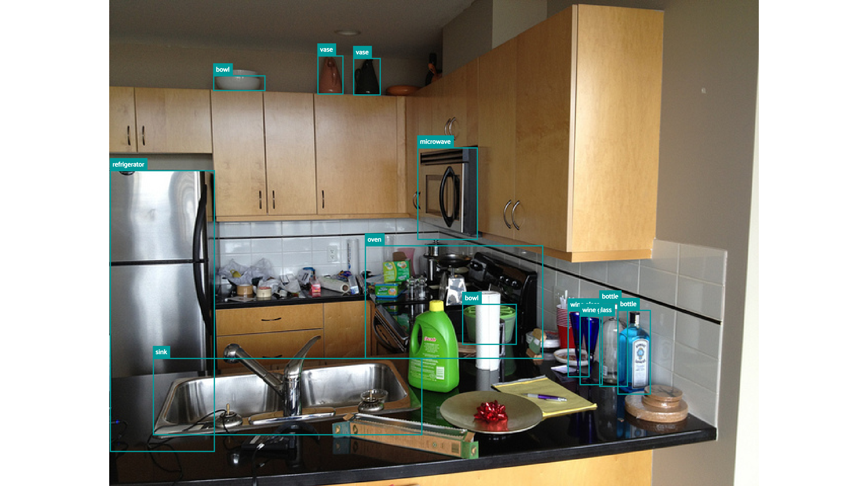
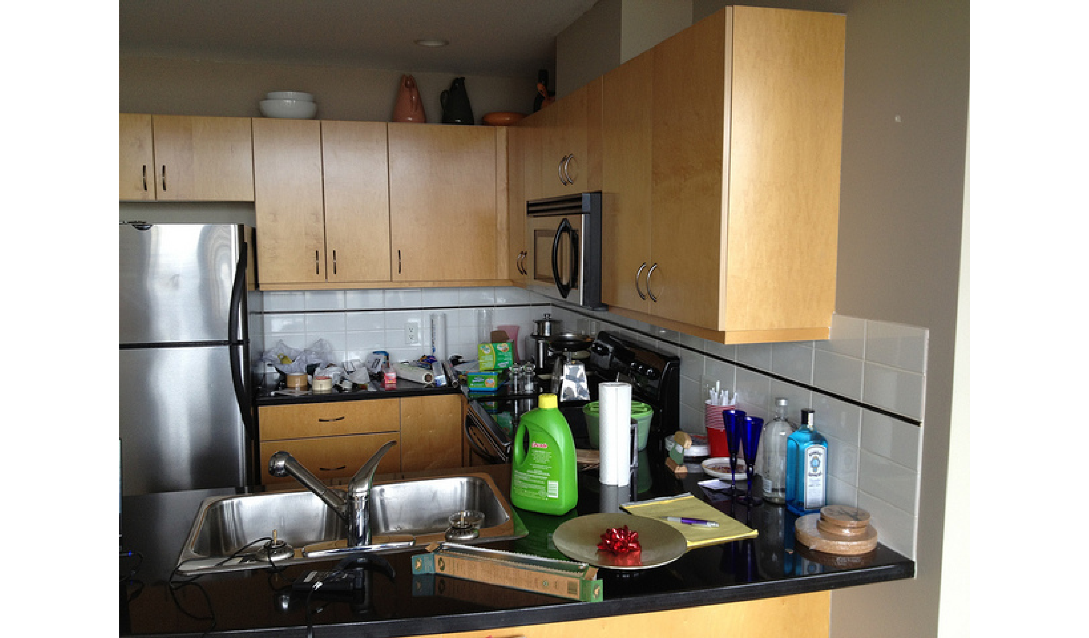
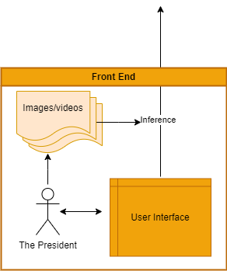
Input Data → Front End
Example Images
With Ground Truth Labels
Without Ground Truth Labels
Notes:
Step 1. You have a labeled in image, put it into front end

Slide 6
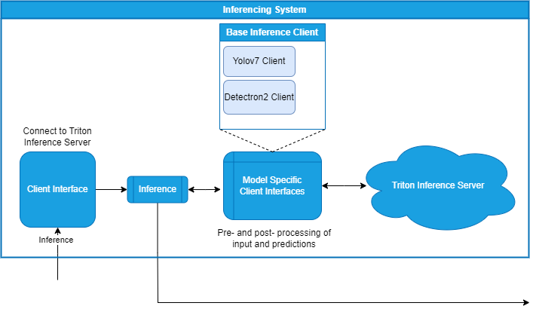
Inferencing System
Structure:
Base client connects to server
Model clients inherit base client
Handles pre- and post- processing
Tools:
Triton Inference Server
Fast, OTS, good documentation, “piping”
YOLOv7
Fast Detection
Mask-rcnn (Detectron2)
SOTA segmentation
{“path/to/image.jpg":
{"detections":
[
{"bbox": [0.26, 0.24434, 0.376, 0.4482],
"label": “BOWL",
"confidence": 0.9648606777191162
},
...
],
"tags": ["validation],
}
...
}
JSON Output
Unlabeled Input Image
Output
Notes:
Put output inside box
Need a way to host the models so they can do work, Triton Inference Server by NVidia is a good way to do that
Client interface (base client interface) acts as a super class boilerplate for connecting client to Triton

Slide 7
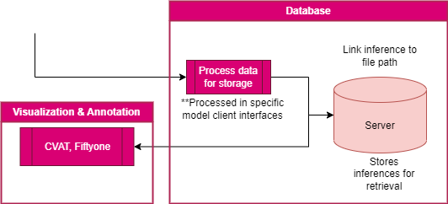
Store Of Information
Structure:
Raw results and image stored on ARCLIGHT server
Fiftyone visualizes results
CVAT validates & merges changes in annotation back to stored results
Tools:
CVAT
Open source, fantastic video annotations
Fiftyone
Customizable, fantastic integration with CVAT
{“path/to/image.jpg":
{"detections":
[
{"bbox": [0.26, 0.24434, 0.376, 0.4482],
"label": “BOWL",
"confidence": 0.9648606777191162
},
...
],
"tags": ["validation],
}
...
}
Output of Inference
Notes:
The recommended workflow is to host the inference results and the images within fiftyone
Inference results is processed into fiftyone format, normalize to standard format

Slide 8
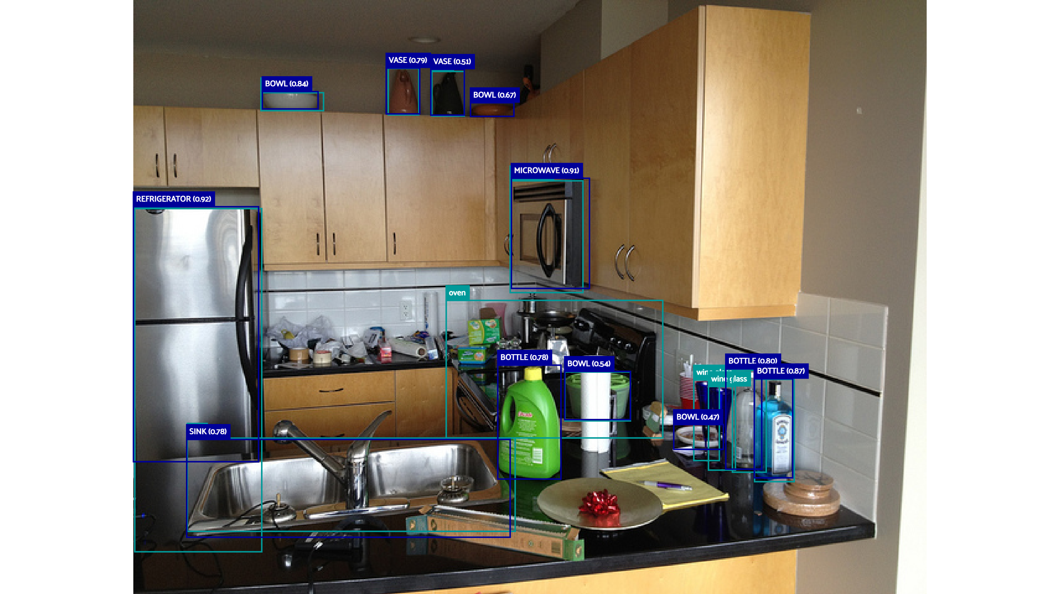
Fiftyone Visualization
Inference result with ground truth labels
Legend
colorrrrrrrr | COCO
colorrrrrrrr | Model
Notes:
Off the shelf yolo not perfect
It misses the wine glasses, a bowl, and the oven, and misclassifies bottles quite frequently

Slide 9

CVAT Annotation in Action
Notes:
Open on YT too
Front end also is for inference, visualize, validate
Added one feature of HAB
After inferencing, results can be sent to Cvat for human corrections
These annotations tools can be used to make ground truth data set if needed, but not necessary

Slide 10
Summary
Designed and implemented a minimum viable baseline for ARCLIGHT
Inferencing System
Data Store
Visualization & Annotations
Front End

Slide 11
Next Steps
* HAB: Human Assisted Baseline
Refine metrics, create plots for comparison
Implement HAB on top framework
Implement HAB model retraining
Move inference server, models, CVAT onto ARCLIGHT server

Slide 12

Conclusion
Notes:
Also put, did I achieve what I wanted
talk about what was interesting to me

